Slide 1
Native American Indians
Geographical Regions
Land, Climate, Plants, Animals
2014
Next

Slide 2
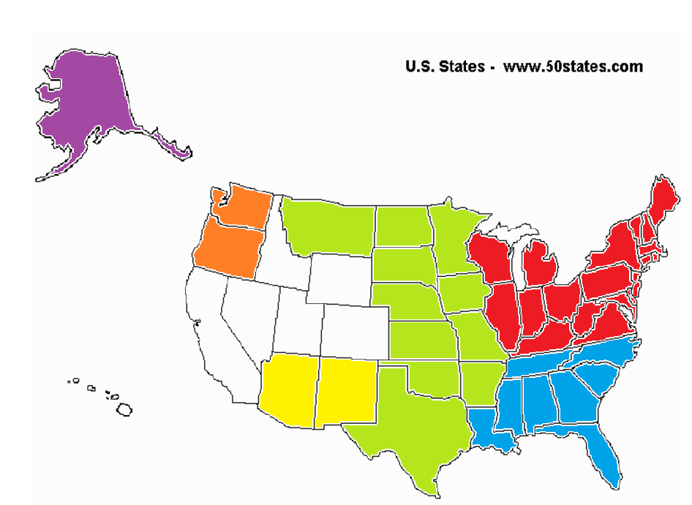
Regional Map
Regional Map
Arctic
California
Great Plains
Southwest
Southeast

Slide 3
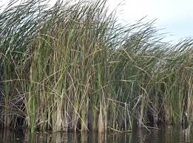
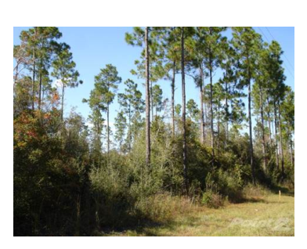
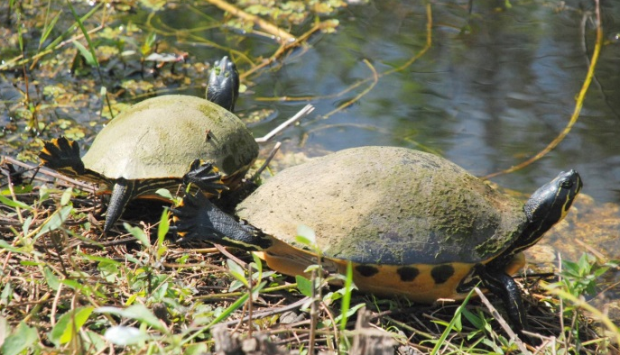
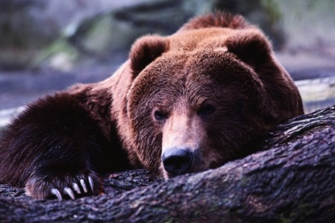
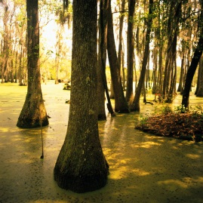
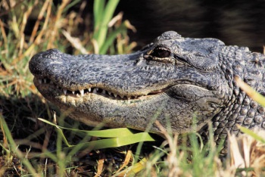
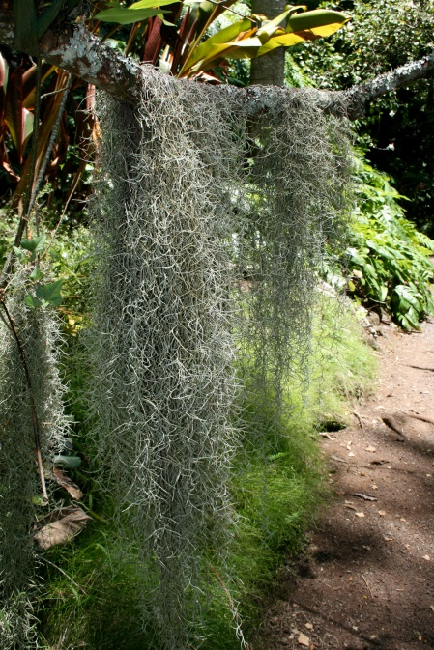
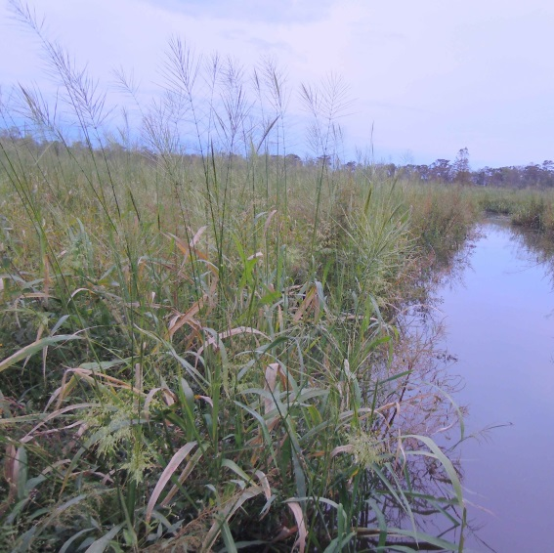
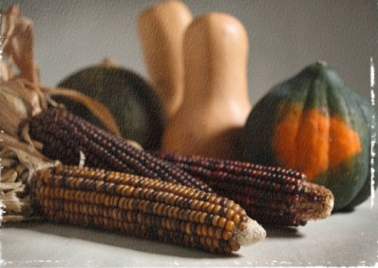
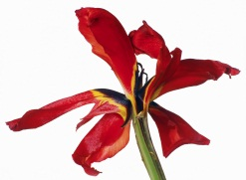
Southeast
sawgrass
Map
turtles
bears
Pine forests
wild rice
alligators
cypress
red iris
blue heron
Spanish moss
Climate/Land | The weather is hot and humid. There are Appalachian Mountains, Everglades(swamps), the Mississippi River Valley, and the seashore.
Plants | Cypress trees grow in the Everglades; Tobacco, corn, beans, squash, berries, and acorns are all important plants.
Animals | The Southeast has turkey, duck, bear, and squirrel
Click here for more

Slide 4
More on the Southeast
Map
There is a great deal of rain in the Southeast. The soil is good for growing crops. Native Americans grew corn and tobacco. Tobacco was used in ceremonies.
The cypress tree grows in swamps. The roots of the tree grow out of the water and look like knees.
Spanish moss grows on the limbs of trees in the South.
Deer were very important to Southeast Native Americans.
Southeast Indians collected shells along the seashore to trade.
Southeast Native Americans celebrated a good corn harvest during the Green Corn Festival.

Slide 5
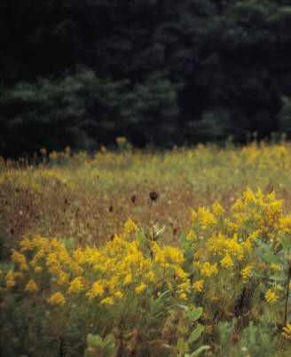
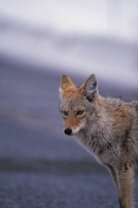
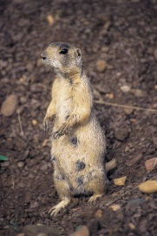
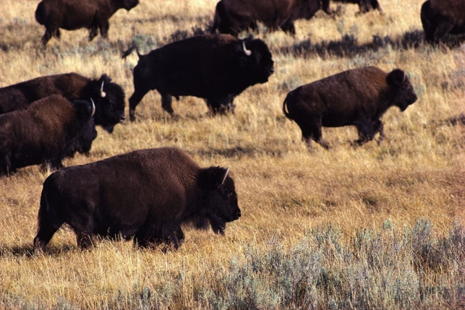
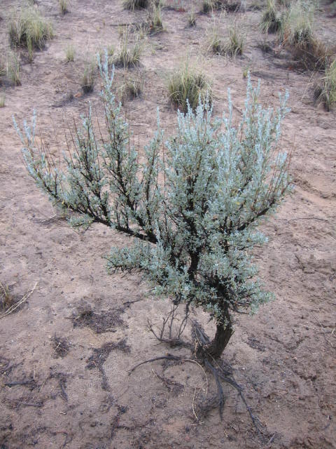
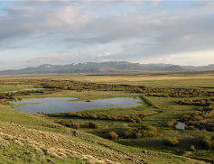
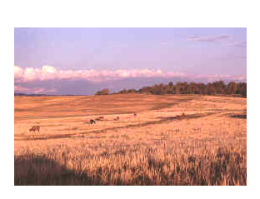
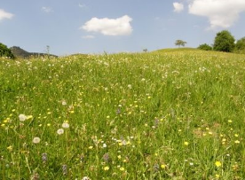
Great Plains
Map
goldenrod
coyote
Prairie dog
buffalo
prairies
Wildflowers
sagebrush
Climate/Land | The rainfall varies. There are high winds at times. The Great Plains has warm summers and cold winters. There are blizzards in the winter. The land is flat. There are lakes, rivers, and few trees
Plants | There are grassy prairies, sage, goldenrod, corn, beans, nuts, and wild berries
Animals | There were many buffalo, coyote, prairie dog, deer, and rabbit
Click here for more

Slide 6
More on the Great Plains
Map
The Great Plains are a huge grassland. Snow covers the ground in winter and it gets very cold. It can be very hot in the summer. There are downpours of rain that last only a few minutes.
There are rivers and streams, but very few trees. The trees grow near the rivers.
Wildflowers were used to make medicine to cure stomach aches and headaches.
Buffalo were very important to Great Plains Native Americans. They used every part of the buffalo.

Slide 7
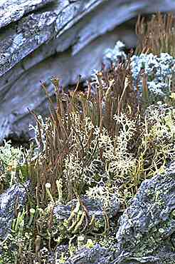
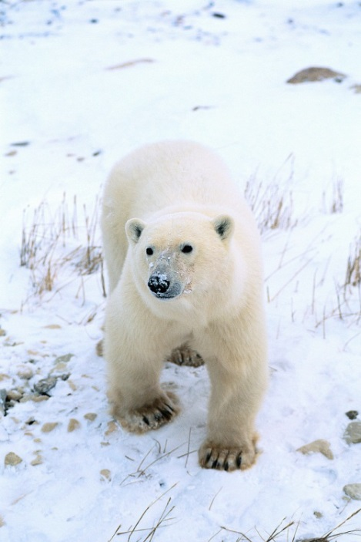
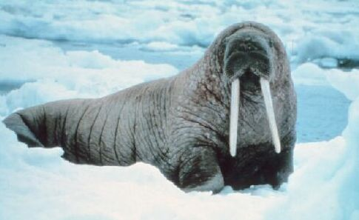
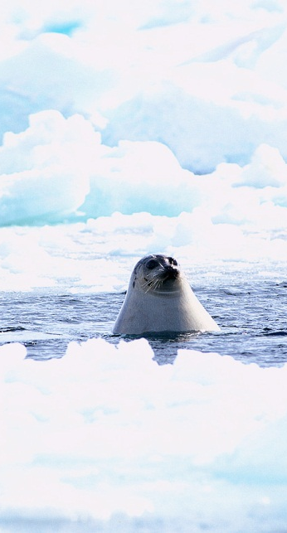
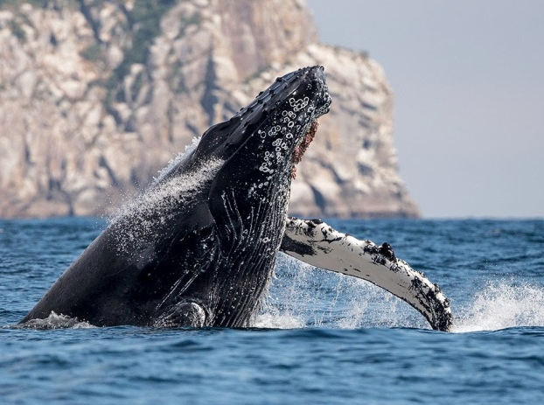
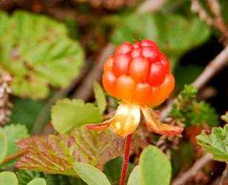
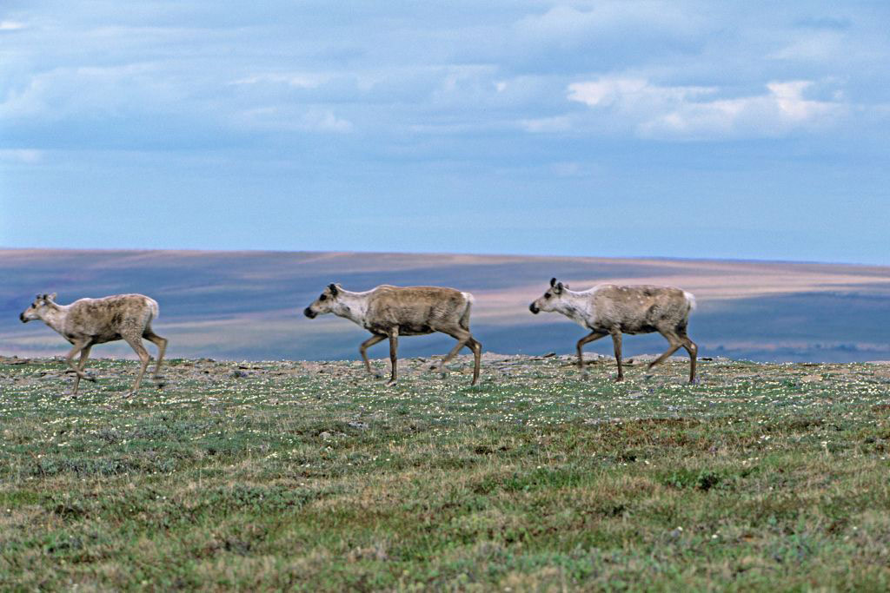
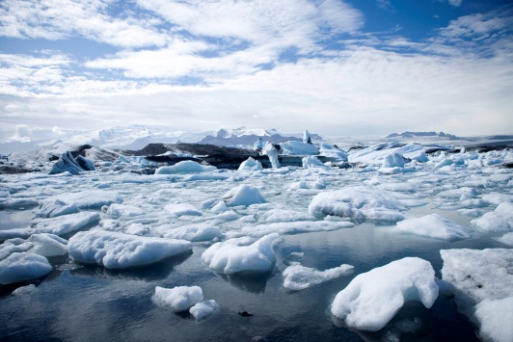
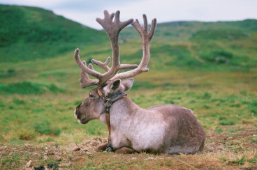
Arctic
lichen
Map
walrus
whale
Cloud berries
Polar bears
seals
reindeer
http://www.roebuckclasses.com
caribou
Climate/Land | It is very cold much of the year. The winters are icy with blizzards and little daylight; everything freezes. There are oceans, lakes, streams, and flat land.
Plants | Berries; small shrubs, and lichen (like moss) grow in the summer.
Animals | Seals, walrus, polar bears, caribou, and trout live in the Artic.
Click here for more

Slide 8
More on the Arctic
Map
The Arctic is in northern Canada, Alaska and Greenland.
Some Inuit moved inland in the summer to gather food like berries.
Inuit collect cloud berries and mix them with seal oil, reindeer or caribou fat, and sugar to make “Eskimo ice cream.”
In the fall, most of the animals went south, to warmer weather. Some Inuit moved their tribes to the shore in winter to hunt sea animals.
Some people call the Inuit, Eskimos. It means “meat eaters”. The Inuit prefer the name Inuit which means “the people.”

Slide 9
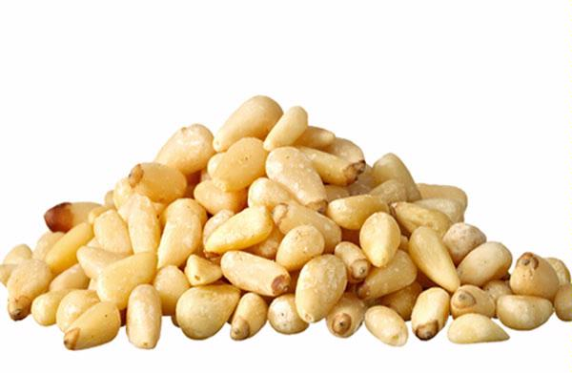
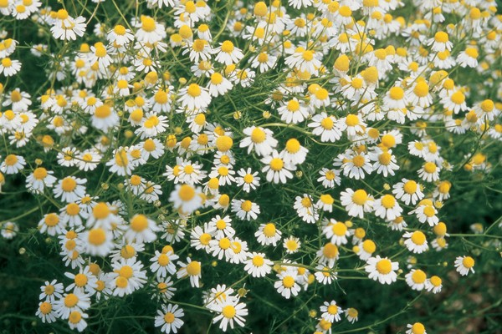
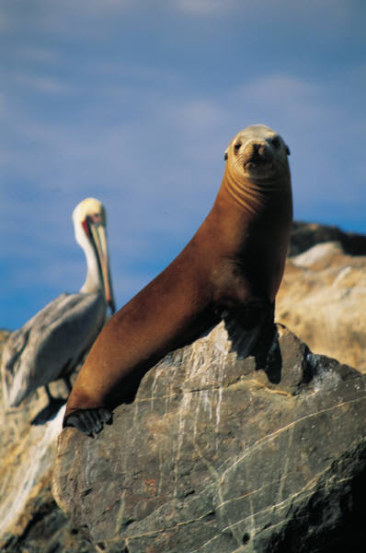
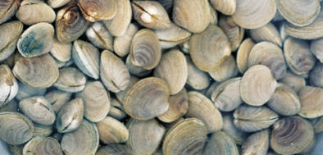
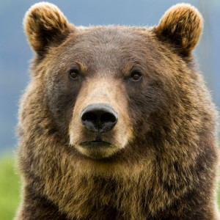
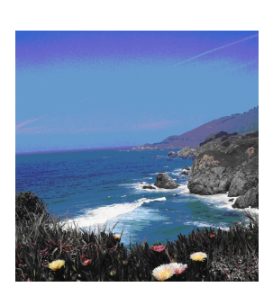
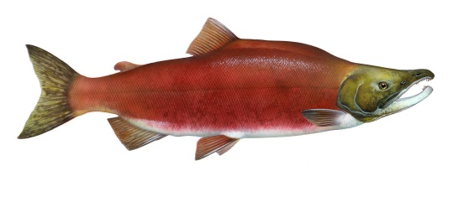
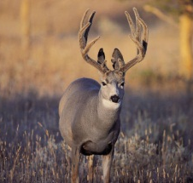
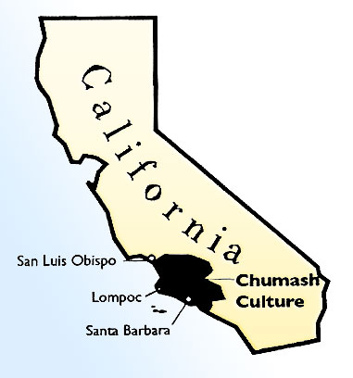

California
Pine Nuts
Map
Chamomile
puma
Grizzly
Bear
seals
Pacific Ocean
salmon
http://www.nps.gov
deer
inlet
Climate/Land | The weather is mild and warm most of the year. The Chumash lived mostly near the coast (ocean), with some living inland near the mountains.
Plants | Plants include walnuts, chamomile, chia seeds, berries, and pine nuts.
Animals | Animals include antelope, bear, birds, deer, mountain lion, and rabbits, along with a variety of fish and other sea creatures (like seals). Shellfish, like clams and mussels, were also in the area and gathered by the Chumash for food.
Click here for more

Slide 10
More on California
Map
The Chumash tribe lived in the central and coastal region of California.
The land in this area had mountains, trees, ocean seashore and fog.
The environment had willow trees, milkweed, tule, bulrushes, cattails and shrubs. Acorns, nuts, fruits, and herbs were also available.
Seals, Walrus, otters, whales, rabbits, oxen, raccoons, deer, squirrels, bear and shark live in this area.
The name “Chumash” probably meant “a people who make shell bead money”.

Slide 11
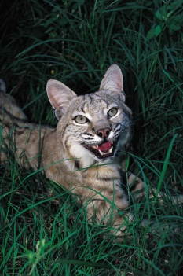
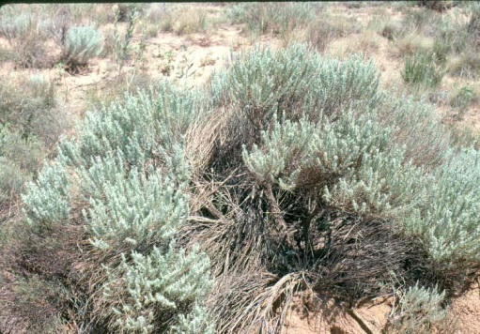
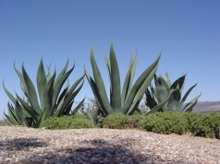
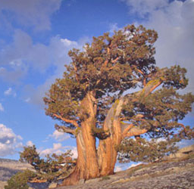
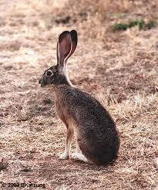
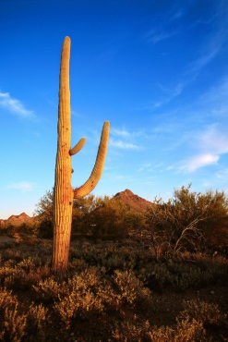
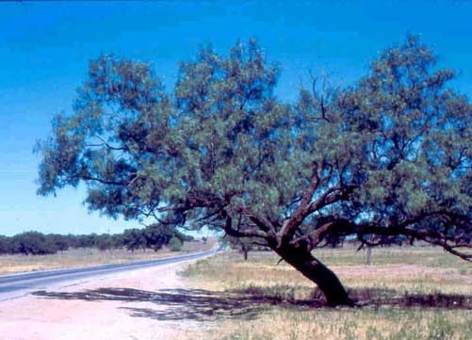
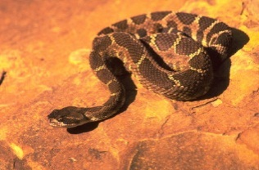
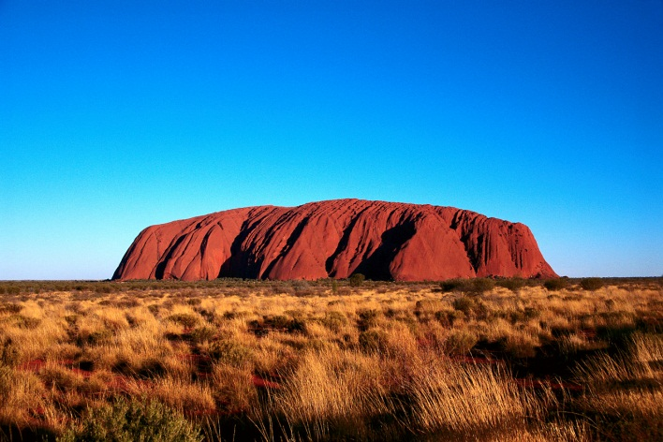
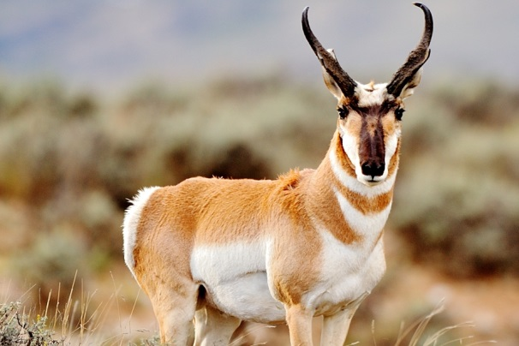
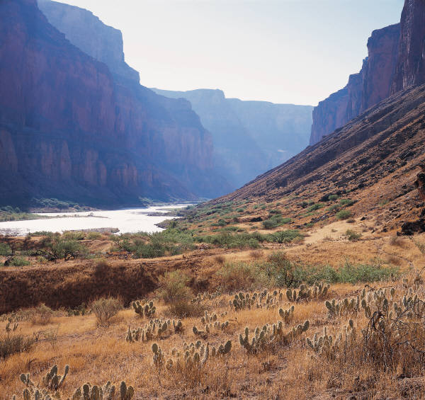
Southwest
Map
Jack
rabbit
sagebrush
agave
juniper
Bob cat
Mesquite tree
cactus
Coral snake
mesa
pronghorn
antelope
canyons
Climate/Land | It is very hot and dry in the desert. The mountains are cold. There are flat mesas.
Plants | Cactus, mesquite and juniper trees, sagebrush, agave, corn, and beans grow.
Animals | The Southwest has jackrabbits, bobcats, coral snakes, coyote, and pronghorn antelope.
Click here for more

Slide 12
More on the Southwest
Map
Some of the Southwest have tall mountains and deep canyons where rivers flow. The riverbeds are made of clay.
The Grand Canyon is in the Southwest.
Pine forests grow on the mountains.
In the south it is mostly desert with sagebrush and cacti. Days can be very hot and nights, very cold. There is not much rain.
The most important foods for the Southwest people were corn, beans, pumpkins and squash.

Slide 13
Bibliography
"Learn About Native Americans." Index. N.p., n.d. Web. 14 Oct. 2014.
Adil, Janeen R. The Northeast Indians: Daily Life in the 1500s. Mankato, MN: Capstone, 2006. Print.
Englar, Mary. The Great Plains Indians: Daily Life in the 1700s. Mankato, MN: Capstone, 2006. Print.
Englar, Mary. The Southwest Indians: Daily Life in the 1500s. Mankato, MN: Capstone, 2006. Print
Peterson, Judy Monroe. The Northwest Indians: Daily Life in the 1700s. Mankato, MN: Capstone, 2006. Print.
Slusher-Haas, Kathy Jo. The Southeast Indians: Daily Life in the 1500s. Mankato, MN: Capstone, 2006. Print

